Slide 1
Coffee Shop Sales Dashboard

Slide 2
Dataset and Data Cleaning
Dataset
Dataset: Coffee Shop Sales Dataset
Records: 1,000 Transactions
Format: Excel (.xlsx)
Features: Transaction Date, Store Location, Product Category, Product Name, Sales, Profit, Customer Type, Payment Method, Rating
Data Cleaning
Checked for missing values
Removed duplicate records
Verified data types and formats
Formatted date and time columns
Validated sales and profit values
Ensured data consistency for analysis

Slide 3
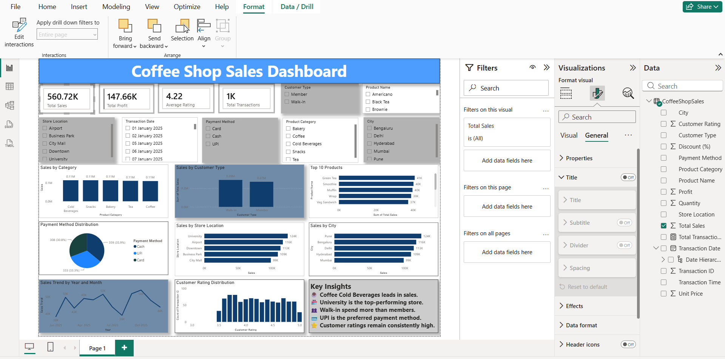
Dashboard Screenshots

Slide 4
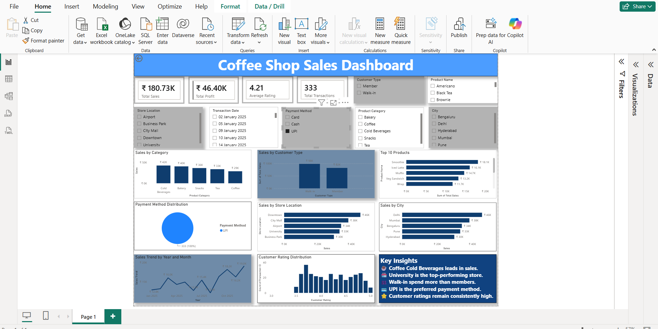
Dashboard with UPI Payment Filter

Slide 5
Key Insights
Coffee products generated the highest sales.
University store achieved the highest sales.
Walk-in customers contributed more revenue.
UPI was the most preferred payment method.
Customer ratings remained consistently high.

Slide 6
Conclusion
Developed an interactive Power BI dashboard for coffee shop sales analysis.
Identified key sales trends, customer preferences, and store performance.
Used KPIs, charts, and slicers to support data-driven decision-making.
The dashboard enables stakeholders to monitor business performance efficiently.

Slide 8


